Slide 1





2024 FINAL PRESENTATIONS
Eco Innovators / CleanCity
Notes:
1.7.2013
‹#›

Slide 2
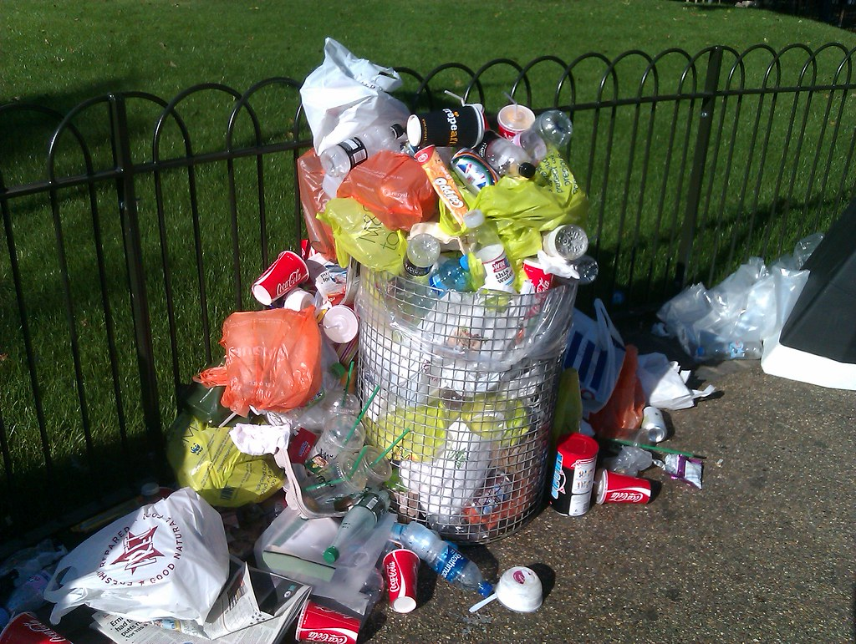
Agenda
Urban areas often struggle with timely waste collection, leading to overflowing bins and unclean public spaces. The current manual process for scheduling waste pickups is inefficient and prone to delays.

Slide 3
Problem Statement
Urban areas often struggle with timely waste collection, leading to overflowing bins and unclean public spaces. The current manual process for scheduling waste pickups is inefficient and prone to delays.

Slide 4
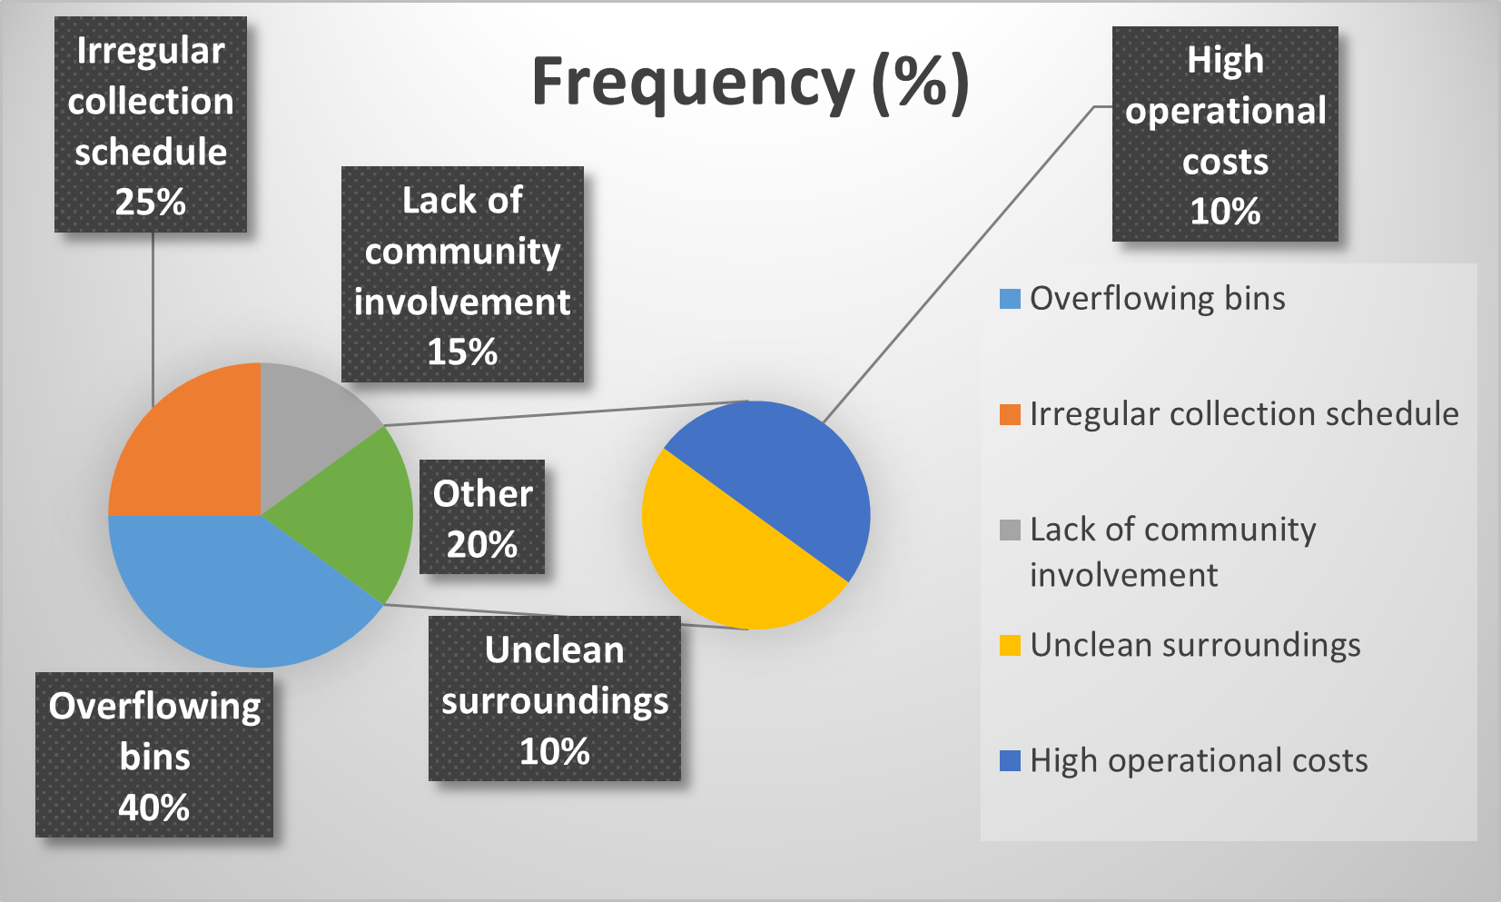
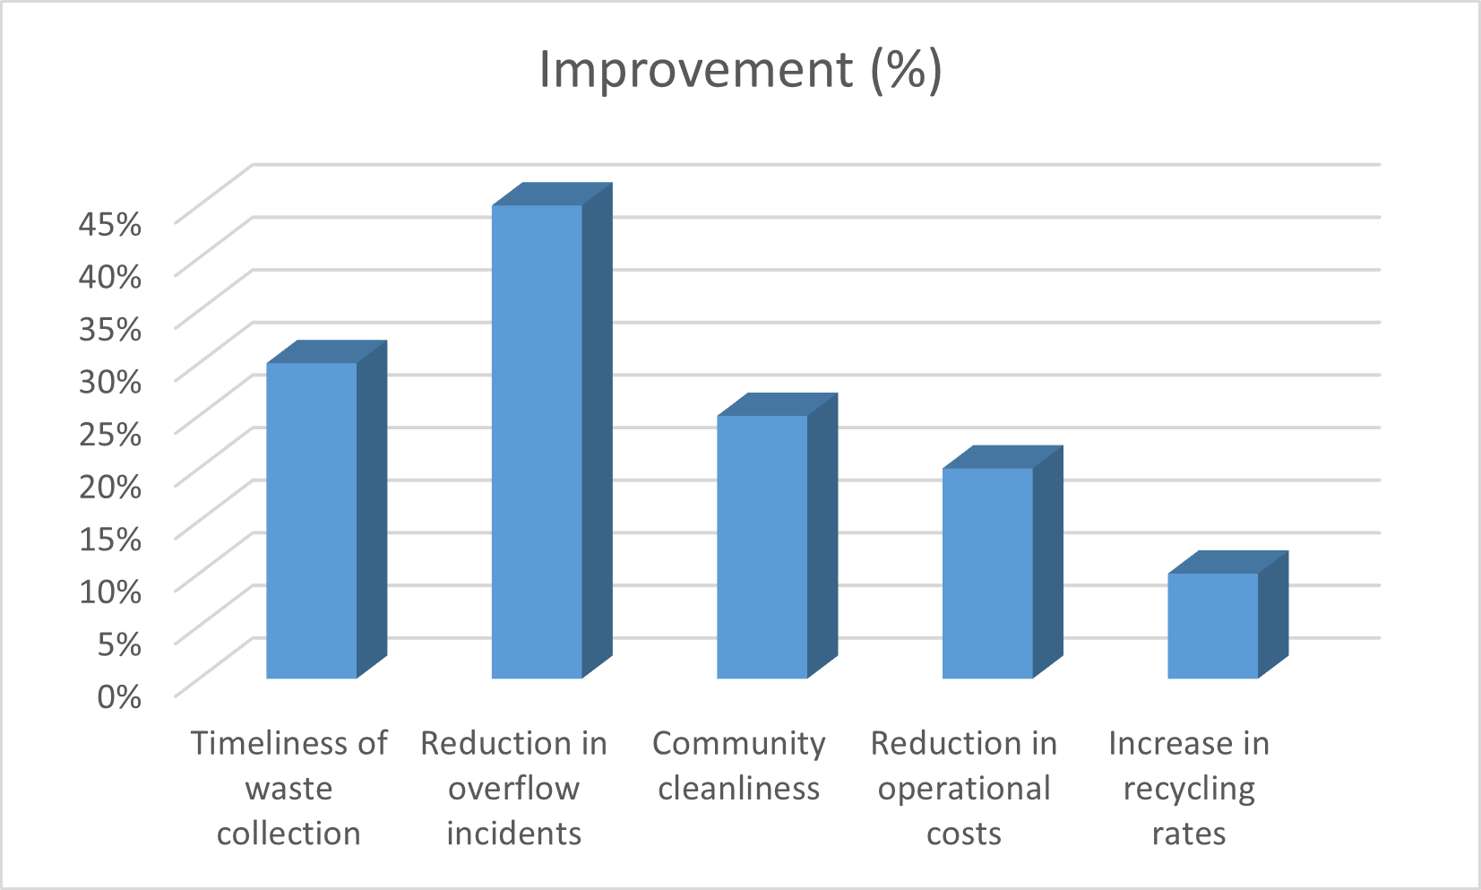
Supporting Data
Traditional Methods (High Costs): Waste collection without optimization, leading to high transportation and labor costs.
With CleanCity (Reduced Costs): Optimized routes and timely pickups reduce fuel usage, labor hours, and other operational costs.

Slide 5
Approach
CleanCity is a mobile app that allows residents and waste management teams to report full waste bins and schedule pickups. The app lets users upload the overflowing dustbins and submit a report when it’s full. Waste management teams receive notifications and can plan pickups based on real-time reports from the community.
CleanCity aims to streamline the waste collection process by involving the community in monitoring waste bins. This will help ensure that bins are emptied before they overflow, contributing to cleaner public spaces and a more efficient waste management system.

Slide 6
Solution Architecture/Flow
Frontend: HTML, CSS, JavaScript (for a simple web-based app).
Backend: PHP (or Node.js) to handle server-side operations.
Database: MySQL for storing user reports, bin locations, and schedules.

Slide 7
Impact
Various issues encountered in urban waste management
Benefits of community involvement using CleanCity
different waste collection methods
Problem
Frequency (%)
Benefit
Improvement (%)
Overflowing bins
Irregular collection schedule
Lack of community involvement
Unclean surroundings
High operational costs
40%
25%
15%
10%
10%
Timeliness of waste collection
Reduction in overflow incidents
Community cleanliness
Reduction in operational costs
Increase in recycling rates
30%
45%
25%
20%
10%

Slide 8
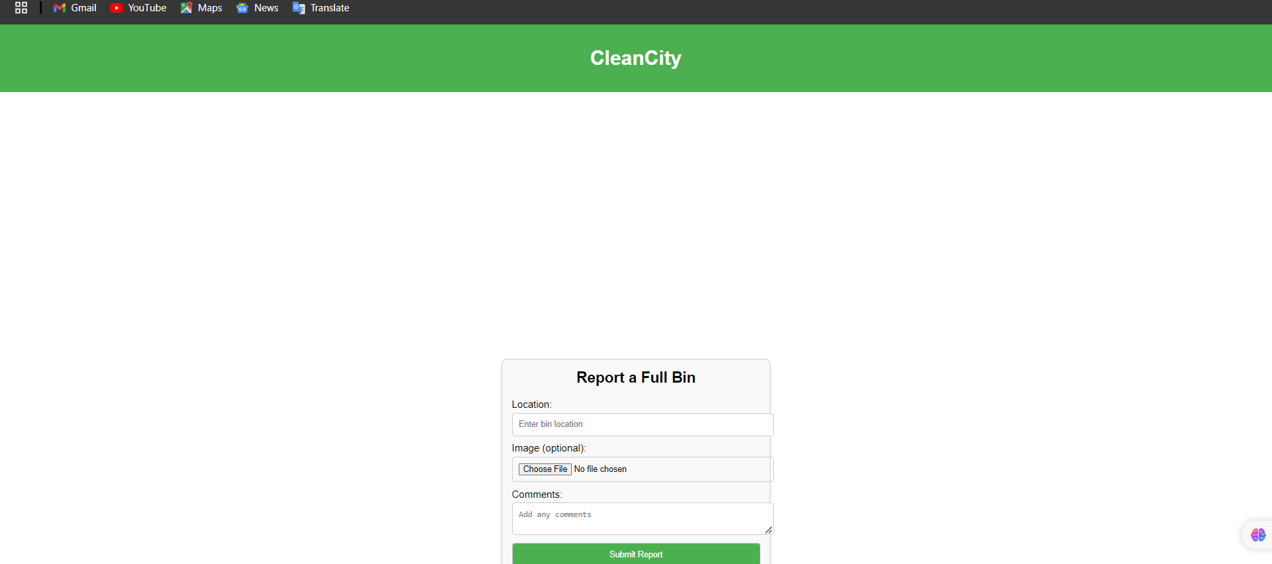
Product Photos

Slide 9
Conclusion
CleanCity is a community-driven waste management app designed to keep urban areas clean by enabling residents to report full waste bins and notify waste management teams. The app uses a simple interface where users can mark bin locations on a map and submit reports. Waste management teams receive real-time notifications, allowing them to schedule timely pickups based on community input. By leveraging the power of community reporting, CleanCity enhances the efficiency of waste collection services and promotes cleaner public spaces.

